Slide 1
Medicare Advantage Quoting & Enrollment
Broker Training
2021
10142021

Slide 2
Training Topics
01 — Locating the MA BoB
02 — Electronic Applications for Medicare Enrollment
03 — Paper Applications for Medicare Enrollment

Slide 3
Locating Your BoB

Slide 4
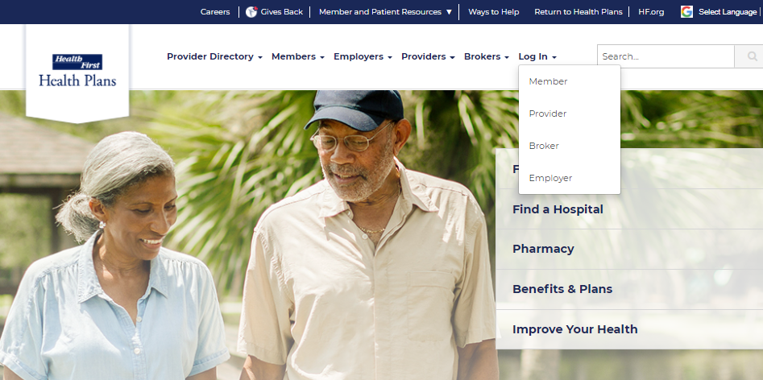
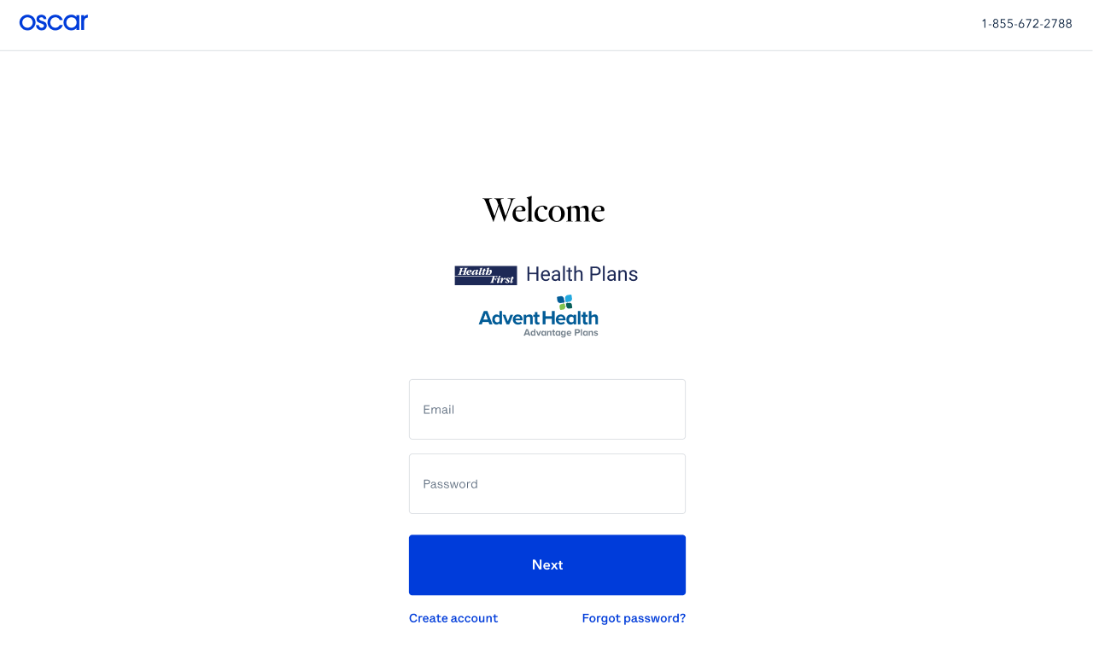
Getting Started – Log In
From the public website, locate the Broker Portal login page:
1. myHFHP.org or myAHPlan.com
2. Click “Login”
3. Click “Broker”
4. Log in
Note: Google Chrome is recommended

Slide 5
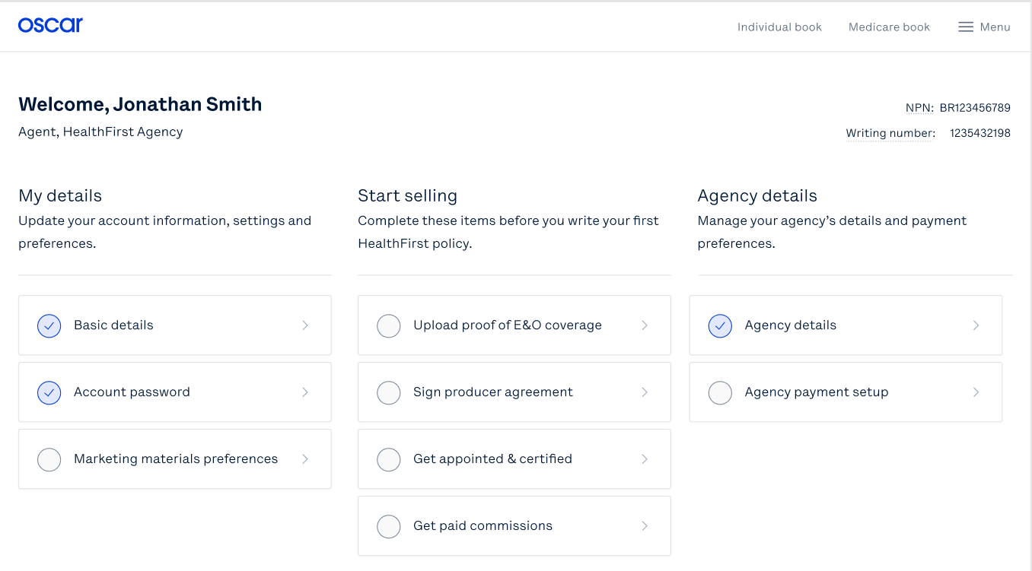
Locating your BoB
To begin, select Medicare book via the top navigation bar of the broker portal
Then, select “Enroll new policy”
Agent, Health First Agency
Complete these items before you write your first Health First policy.
Note: Historical data (2021 plan information) will not be populated in the Broker Portal. Member payment information will need reestablished.

Slide 6
Electronic Applications

Slide 7
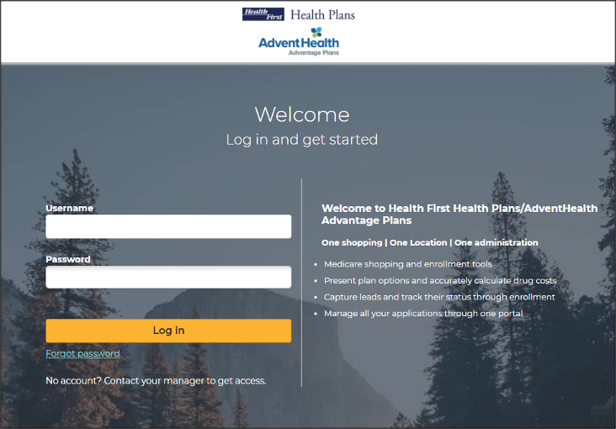
Medicare Enrollment Portal Login
You will be brought to the Medicare Enrollment Portal
Note: Save the URL in your browser “bookmarks” for easy, future access.
Notes:
Once you click on the “Enroll new policy” you will be brought to the MA portal

Slide 8
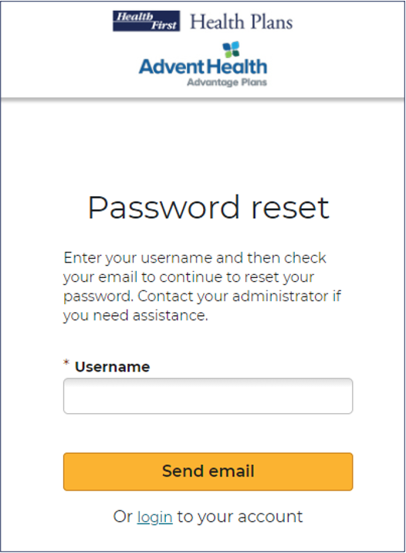
Initial Login, Reset, Forgot Password
As a broker, the first time you log in, you will need to use the Forgot Password link. This link is also used if you forget your password or wish to reset it.
Click the Forgot Password link.
Enter your NPN in the *Username field.
Click Send email
Log into email & verify email

Slide 9
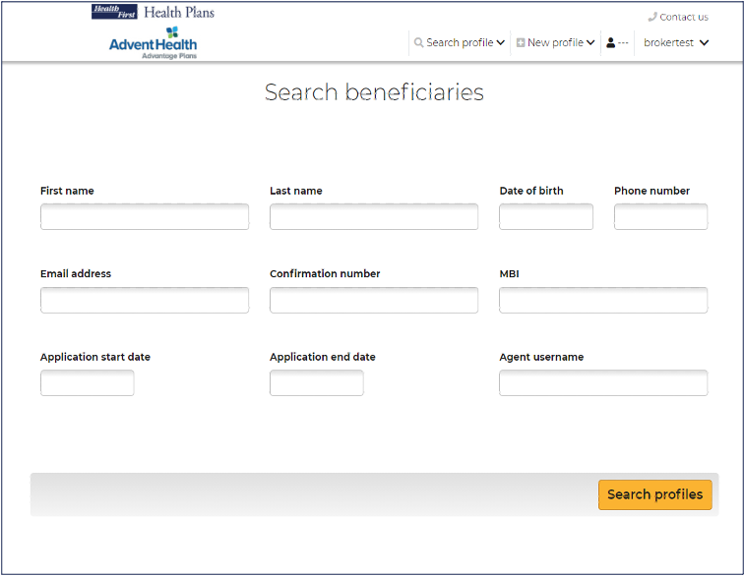
Search Beneficiaries
After logging in, the Search Beneficiary screen will display.
Use the top navigation bar to:
Search Profile
Create a New Profile
Access your Broker Profile

Slide 10
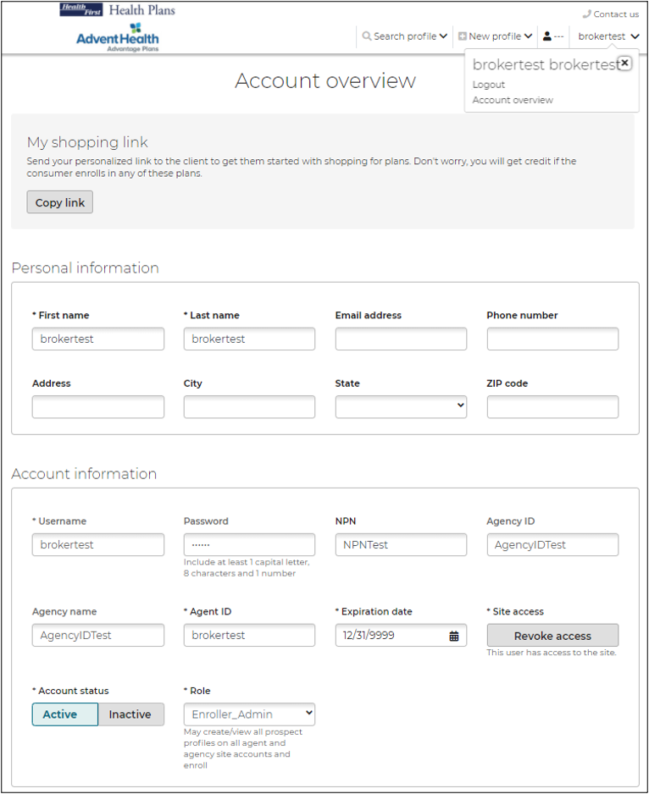
Top Navigation: Broker Profile
View and edit your account information and/or log out of the portal.
Username: this field will always be your National Producer Number (NPN).
Account Overview: Broker demographic overview including username and password.
Logout of the portal

Slide 11
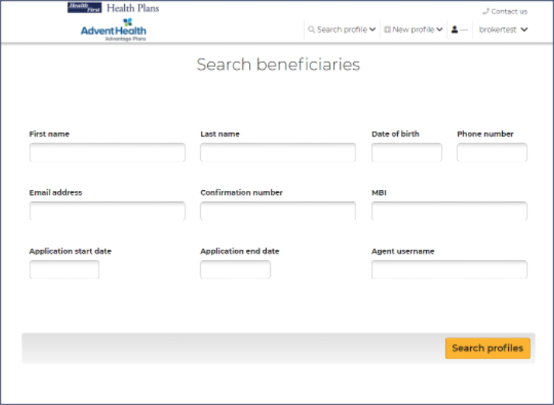
Top Navigation: Search Profile
Search for an existing beneficiary profile in the system. If a beneficiary profile exists, clicking this option will enable you to access the beneficiary's saved information, including any enrollments in progress.
To search for a beneficiary:
1.Enter search parameters
2.Click Search profiles
Registrant status indicates a beneficiary who has not started an enrollment application.
Applicant status indicates a beneficiary who has either started or completed an enrollment application
If no search results are found, create a new profile and the search criteria that was entered will be automatically pre-filled into the New Profile.

Slide 12
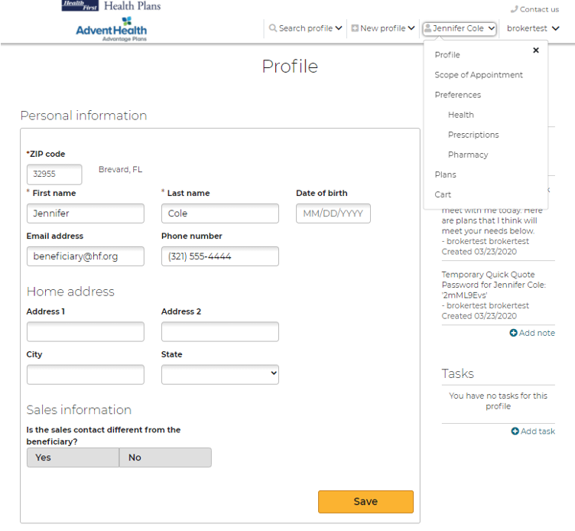
Top Navigation: Beneficiary
After (1) searching for an existing beneficiary profile in the system and (2) selecting the client you would like to review, this beneficiary name will populate in the top navigation with a set of drop-down options to work from

Slide 13
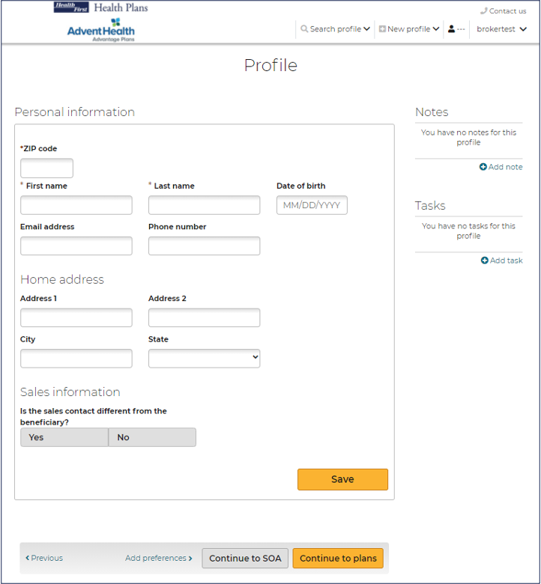
Top Navigation: New Profile
If a beneficiary profile does not exist in the system, follow these steps:
To create a New Profile:
1.Click New Profile
2.Enter required information
3.Click Save
After a New Profile is created, you can:
Edit the beneficiary’s information
Shop for plans
Add preferences information
Send a Scope of Appointment
Send a Quick Quote
Start Enrollment

Slide 14
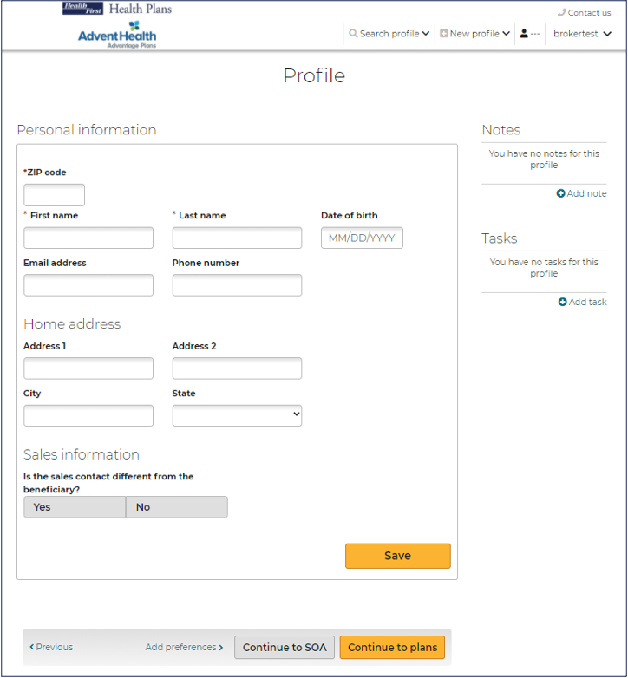
Profile Notes
Notes can be added to track:
Sending electronic SOAs
Enrollment applications sent via email or text
Some actions agents perform in the system generate notes automatically. For example, when agents send an electronic scope of appointment form, the email and date are added as a note.
Click Save after entering any Notes.
Notes:
Scope of Appt

Slide 15
Profile Tasks
Tasks allow you to create reminders to perform actions to assist a beneficiary. These include:
Check SOA completion
Email materials or plan documents to beneficiary
Upload/view SOA’s from desktop
Document a scheduled meeting with the beneficiary
Click Save after entering any Tasks.
Click Continue to plans or Continue to SOA, below the profile form.

Slide 16
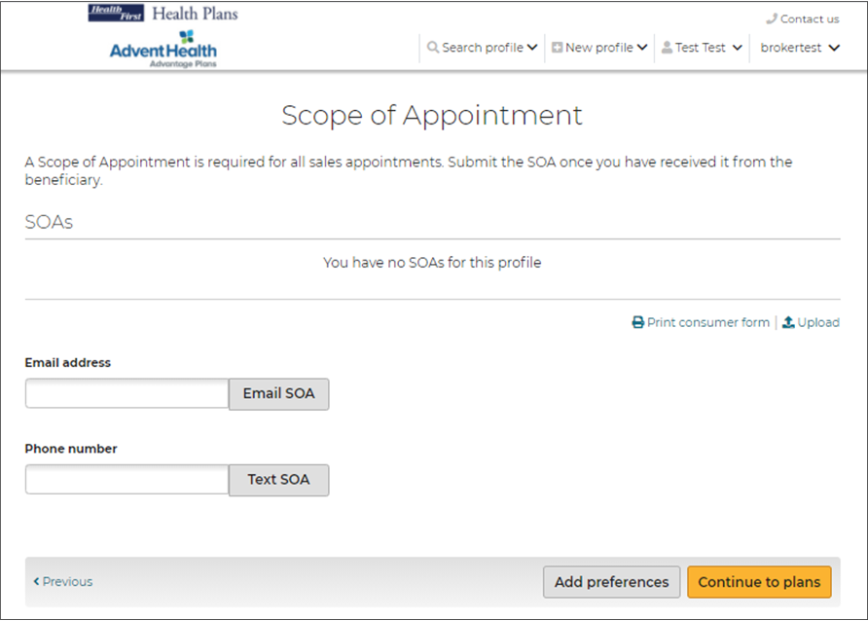
Scope of Appointment
View uploaded SOA’s
Upload new SOA’s received
Complete an SOA after the appointment
SOA’s sent via email or text will be documented in the Notes section

Slide 17
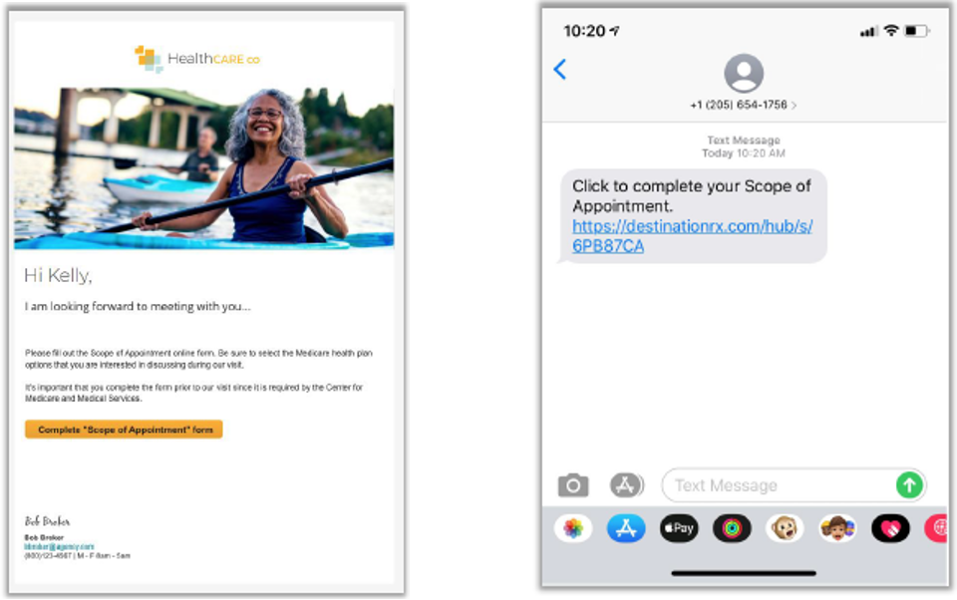
Scope of Appointment Sent to Beneficiary
Sample Email
Sample Text

Slide 18
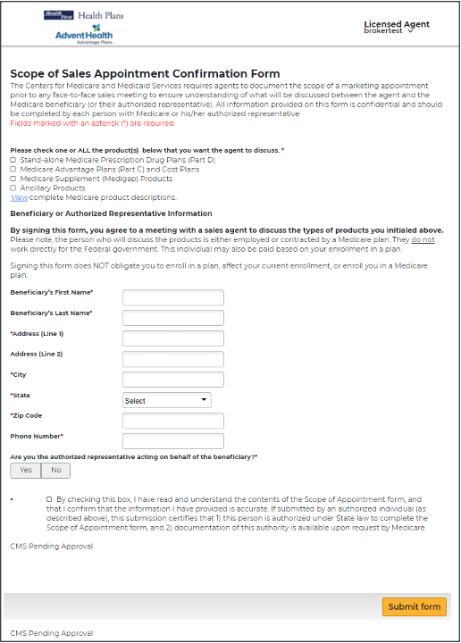
Scope of Appointment Received by the Beneficiary
This is a sample form the Beneficiary will see when the link in the email or text is selected.
Agent information will appear in upper right of the header.
The Beneficiary will choose options from the form to discuss at the appointment, complete all required fields, and submit the form.

Slide 19
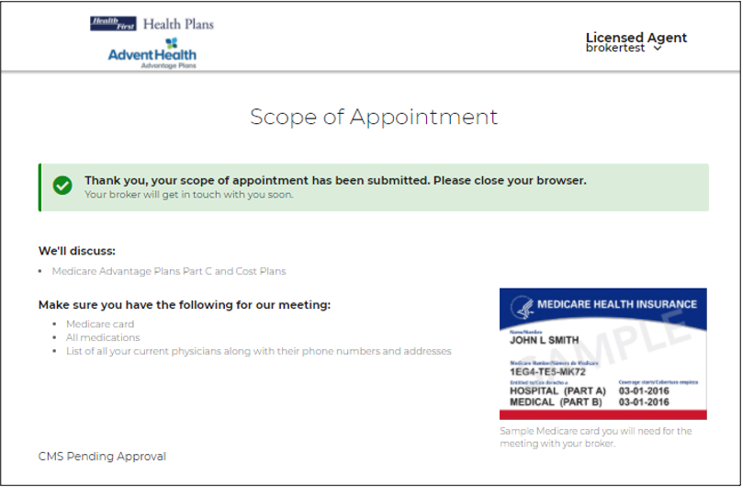
Scope of Appointment Confirmed by the Beneficiary
The Beneficiary will receive a confirmation message once they have successfully submitted their completed SOA.

Slide 20
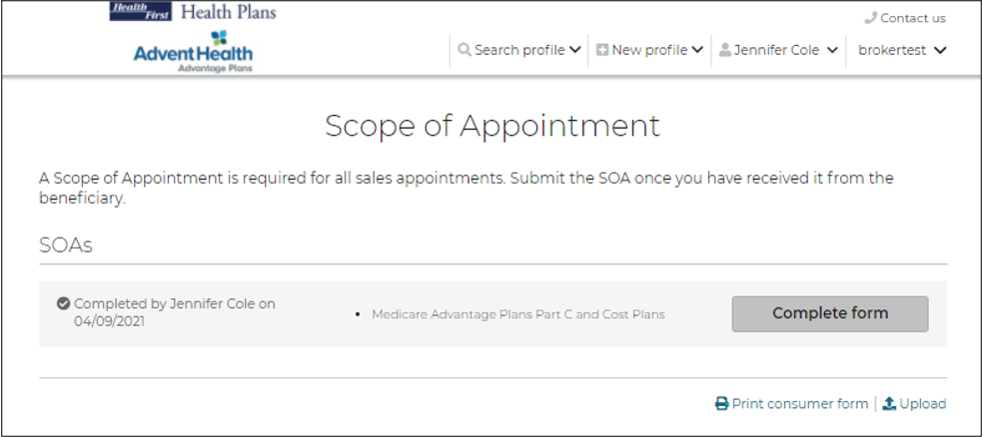
Agent Completion of the Scope of Appointment
The agent will receive a notification email (if the agent has an email on file) that the beneficiary has completed their portion of the form.
The agent will log into the system, search for that beneficiary, navigate to the SOA page, and click Complete form.

Slide 21
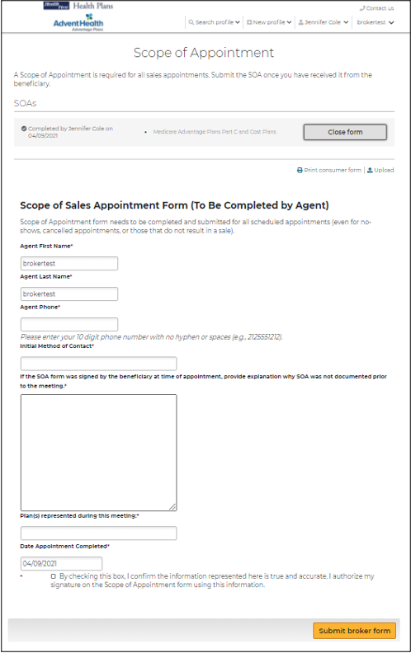
Agent Completion of the Scope of Appointment
This is a sample form the agent will see when they click to complete their portion after received back from the beneficiary.

Slide 22
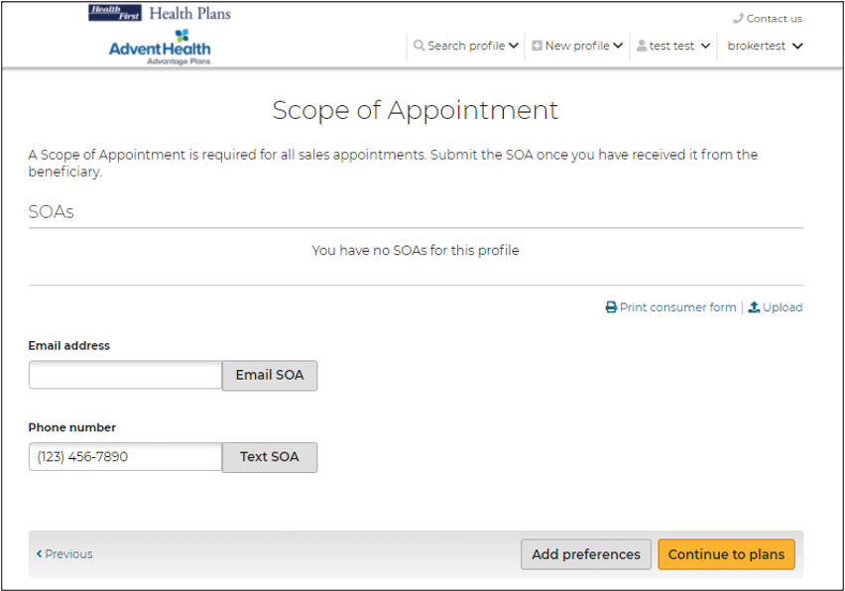
Uploading a Scope of Appointment
To upload an SOA that was completed outside of the system, click the Upload link on the SOA page and upload the document.

Slide 23
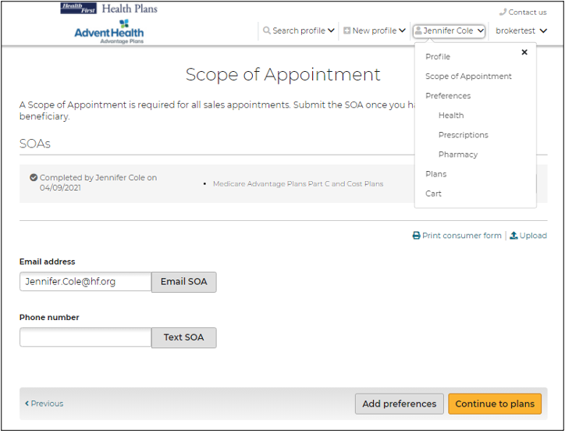
Getting Started
After the SOA is complete - get started with adding preferences, reviewing plans, and starting enrollment.
From the Beneficiary’s tab, click Preferences
Or click the Add preferences button from the bottom of the SOA page.

Slide 24
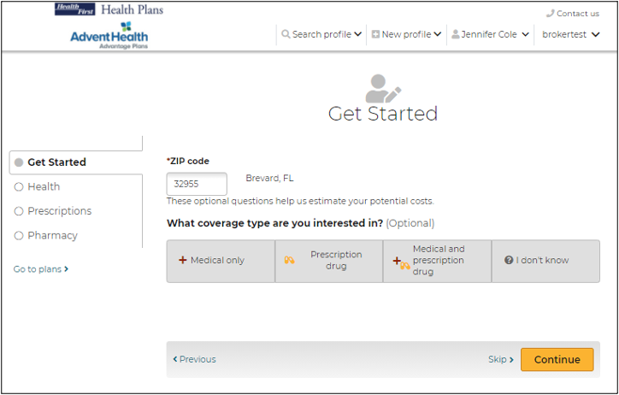
Getting Started
On the Get Started page, agents can provide the beneficiary’s zip code, select the interested coverage type and the Low-Income subsidy amount.
Providing the beneficiary's subsidy information allows the system to adjust premiums, prescription deductible and prescription copays in the plan cost estimates.
While working with a beneficiary profile, agents can access this page by selecting Preferences from the drop-down option.

Slide 25
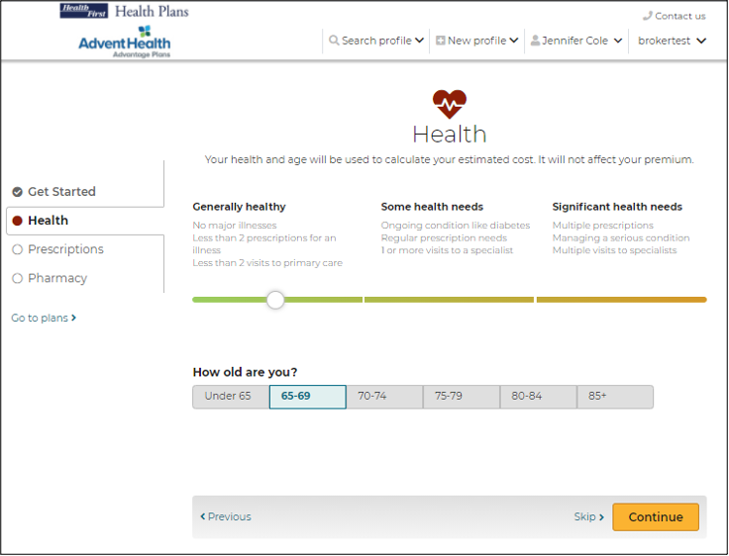
Getting Started - Health
Entering information about the beneficiary's location, age range, and health provides a list of available plans and calculates estimated out-of-pocket medical expenses.
While working with a beneficiary profile, agents can access this page by selecting Health from the drop-down option.

Slide 26
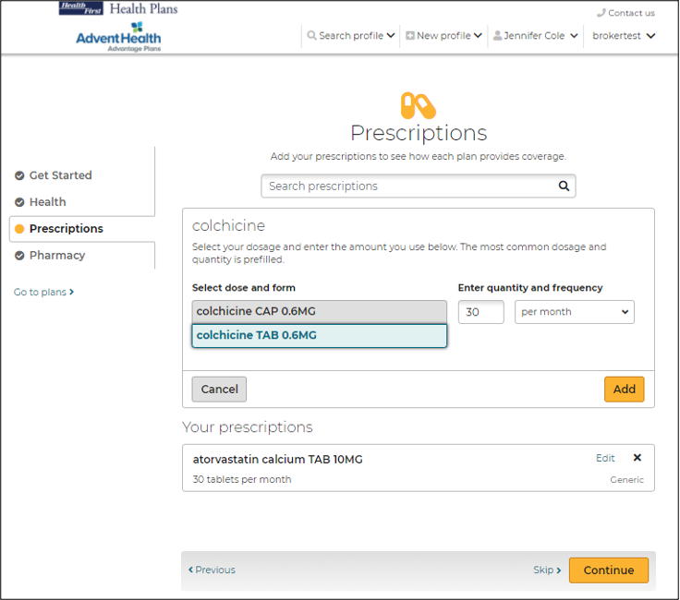
Getting Started - Prescriptions
It is recommended the beneficiary provide prescription drug information, as this allows agents and the beneficiary to understand if and how their drugs are covered and to provide a better out-of-pocket cost estimate.
Note: This step can be skipped by clicking Skip or Continue at the bottom of the page
While working with a beneficiary profile, agents can access this page by selecting Prescriptions from the drop-down option.

Slide 27
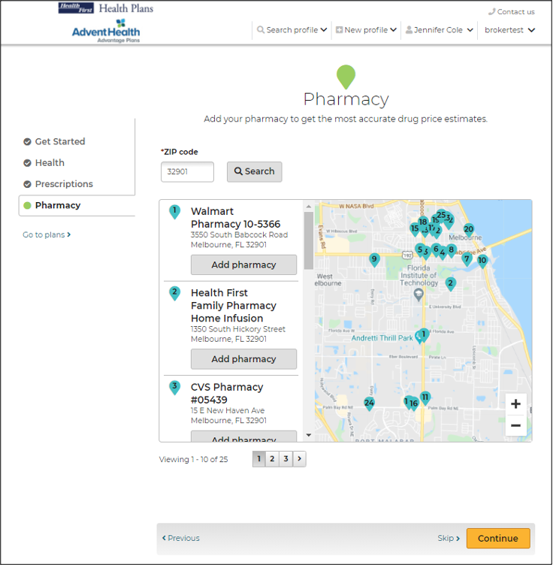
Getting Started - Pharmacy
The Pharmacy page allows agents to enter the place where the beneficiary fills prescriptions. This allows the system to provide more accurate prescription pricing.
Note: This step can be skipped by clicking Skip or Continue at the bottom of the page
While working with a beneficiary profile, agents can access this page by selecting Pharmacy from the drop-down option.

Slide 28
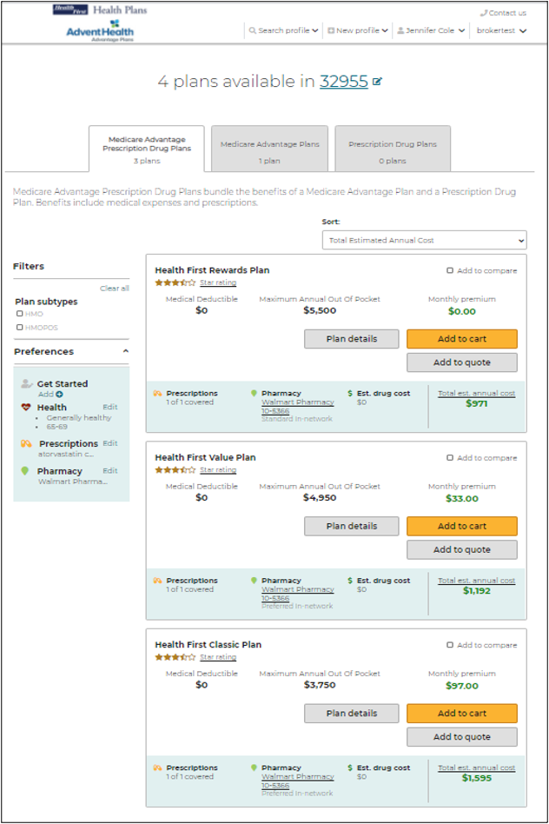
Plans
The Plans page allows agents to view all the plans that are available in the beneficiary’s service area.
The available plans, plan pricing, and estimated costs are impacted by several factors including the beneficiary's location, subsidy eligibility, prescription drugs, and pharmacy selected.
Plan cost estimates are more accurate with more information entered for the beneficiary.

Slide 29
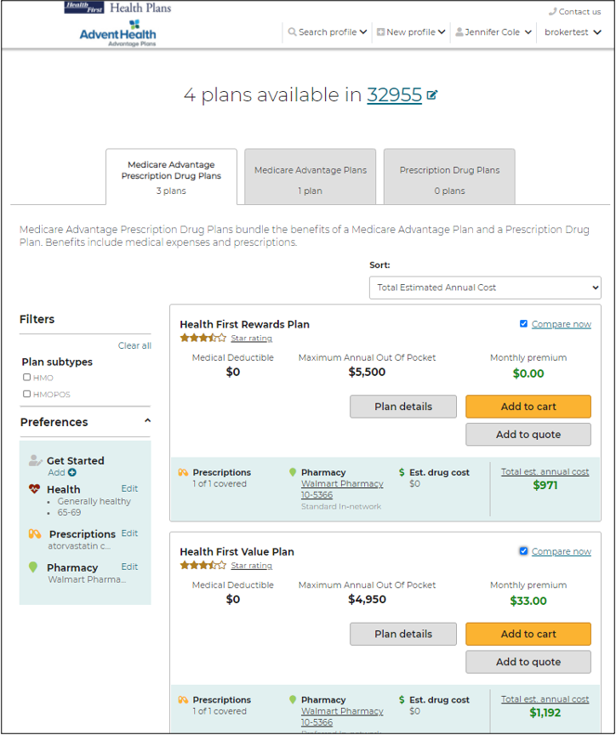
Compare Plans
Agents can compare up to 3 plans side by side on the Compare Plans page.
Check the boxes of the plans you’d like to compare, then click, Compare now.

Slide 30
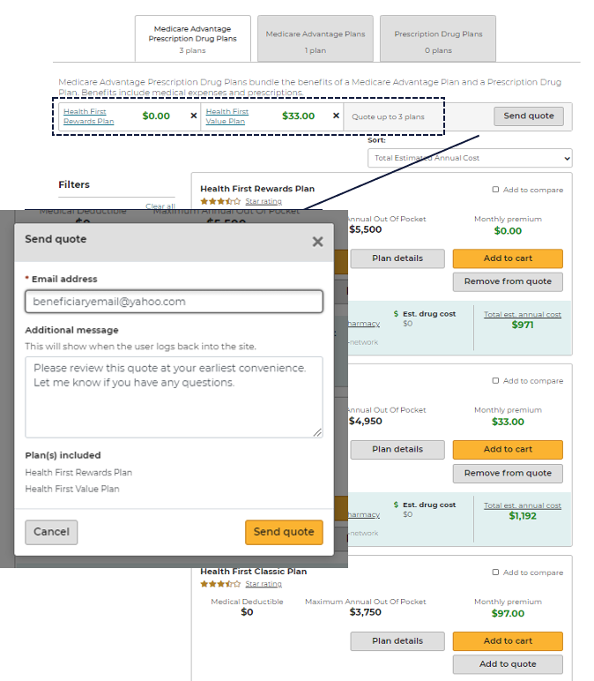
Send a Quote to the Beneficiary
Agents can add specific plans to a quote and email to their beneficiary by clicking Add to quote.
The selected plans will list at the top. When you are ready to email to your beneficiary click, Send quote.
A message window will display asking for the beneficiary’s email and message to accompany the quote. Click Send quote when finished.

Slide 31
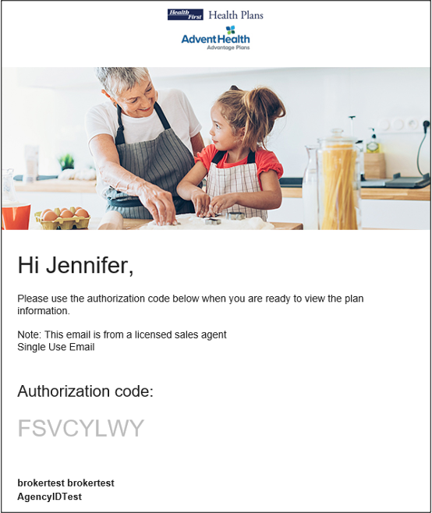
Send a Quote to the Beneficiary
When a quote is sent successfully, the beneficiary receives two emails that can be used to access the quote:
One with the link to view the quote
One with the access code
These are separate for security reasons because protected health information (PHI) is involved.

Slide 32
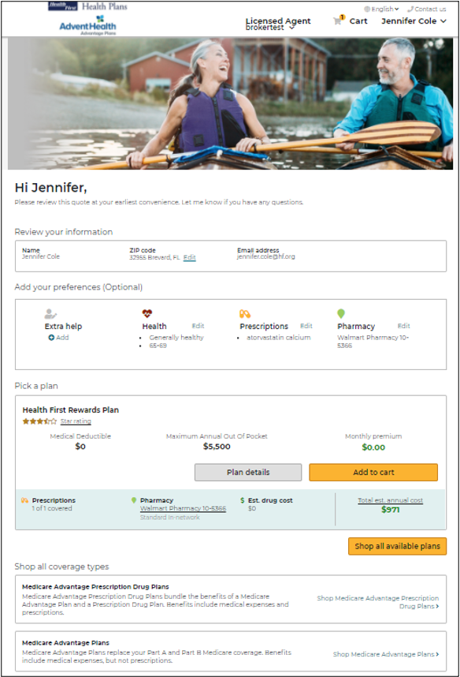
Quote Authorization and Summary
Upon successful authentication, the beneficiary lands on the quote summary page.
The beneficiary, will have access to Add to cart and continue to the enrollment process if they choose.
The links provided in the email contain the Agent ID, which ensures agents get credit for any enrollments that result from the Quote.

Slide 33
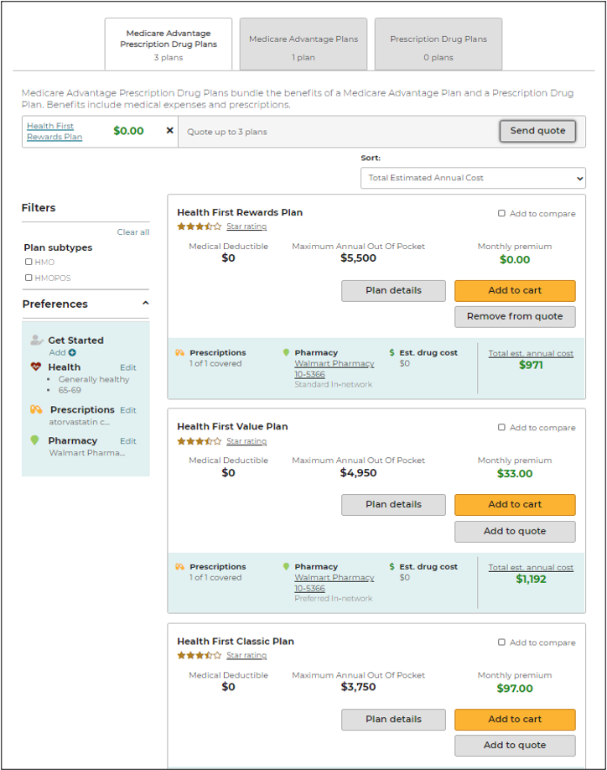
Start Enrollment Add to Cart
Once the beneficiary has made their plan selection, the agent can begin the enrollment process.
First, click Add to cart next to the plan option the beneficiary has selected.

Slide 34
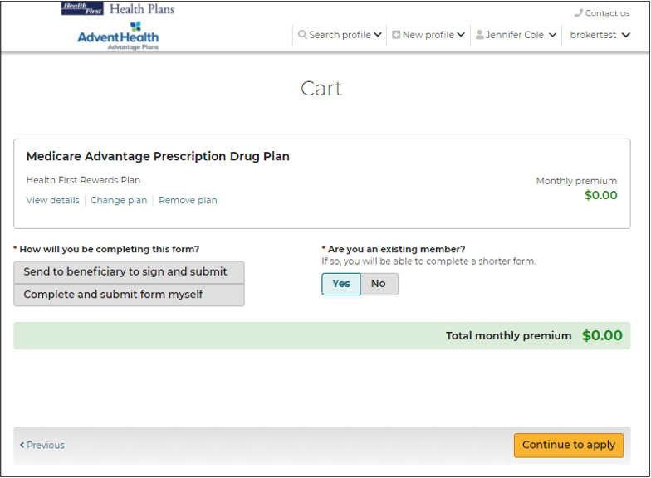
Start Enrollment Add to Cart
Two options are offered:
Enrollment can be completed through sending to the beneficiary to sign and submit
Agent can complete and submit the enrollment on behalf of their beneficiary ONLY if the agent is sitting with their beneficiary to complete this enrollment.
Also, be sure to note if this beneficiary is an existing member. If yes, it will result in completion of a shorter enrollment form.
Click, Continue to apply to move ahead with the application.

Slide 35
Enroll a Beneficiary
Agents that select the option: Complete and submit form myself
The electronic enrollment form will guide agents through a 5-step process of submitting the enrollment application.
Fields marked with an asterisk are required and agents will not be able to proceed until marked.
Beneficiaries will need to be present with their agent in order to sign the application at step 5.
To complete the enrollment, agents will click Submit at the bottom of step 5.

Slide 36
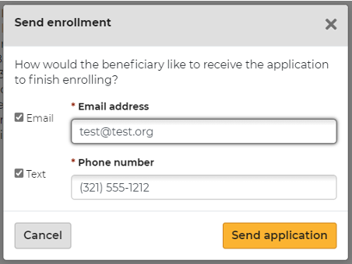
Enroll a Beneficiary
Agents that select the option: Send to beneficiary to sign and submit
The electronic enrollment form will guide agents through a 4-step process.
Fields marked with an asterisk are required and agents will not be able to proceed until marked.
Agents will complete their portion of the enrollment and click Send to beneficiary at the bottom of step 4.
An email or text will be sent to the beneficiary to review, sign, and submit the completed enrollment application.
Note: The beneficiary will either receive two texts or two emails, one with the link and one with the authorization code.

Slide 37
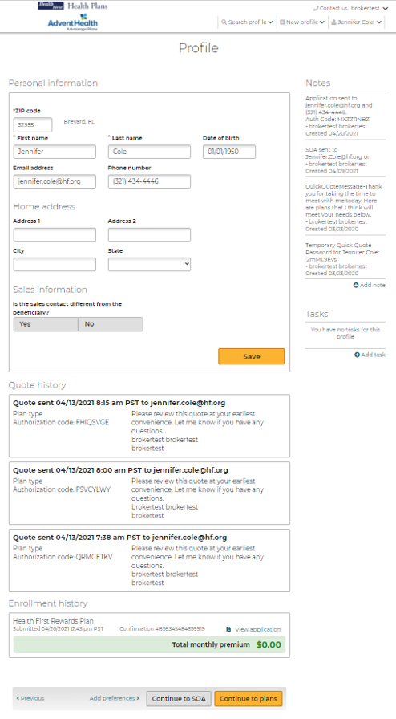
Enrollment History
There will be no email notification to the agent.
Agents will need to log back into the Medicare Enrollment Portal and check the beneficiary's profile for enrollment completion.
The Profile page allows agents to view a beneficiary’s enrollment history.
Agents can access this page by:
searching for a profile
opening the profile
then scrolling down to the Enrollment history section

Slide 38
Enrollment History
Three types of enrollment status information may display under the Enrollment history section:
Current year in-process enrollments at the top of the list. These are applications that have been started but not completed for the current plan year and will offer a link to Continue enrollment.
Current year completed enrollments are listed below the in-process enrollments. These are completed enrollment applications for the current plan year and may include information about riders, documents uploaded during enrollment, and the ability to view the PDF of the application.
Past enrollment information is at the bottom. This may include plan name and other information.

Slide 39
Paper Applications

Slide 40
Paper Applications
Health First Health Plans requests that all contracted agents use the Medicare enrollment portal to submit electronic enrollments. However, we also accept paper applications. For 2022 enrollments and beyond, please follow the below.
Paper Applications:
May be faxed to: 833-582-2838 within 24 hours of signature
May be mailed to: Health First Health Plans
P.O. Box 62045
Phoenix, AZ 85082
Note: The ‘received date’ is used when determining eligibility, not the ‘postmarked date.’ Please ensure that all applications are received, in-hand, no later than December 7th.

Slide 41
Paper Application Recommendations & Best Practices
Complete all required fields on the enrollment application legibly. Our inability to read or interpret information on the application can result in processing delays and/or application denials.
If enrolling a beneficiary via paper application, always use the Health First Health Plans enrollment application provided in the 2022 MA sales kit to complete the enrollment.
Be sure to submit a completed Scope of Appointment along with the enrollment application and the Attestation of Eligibility for an Enrollment Period, the latter only for enrollments conducted outside of AEP.
Read all required disclosures on the enrollment application to the beneficiary and confirm understanding. As a best practice, have the beneficiary initial next to each paragraph.

Slide 42
Post Enrollment

Slide 43
Next Steps
There will be no email notification to the agent. Agents will need to log back into the Medicare Enrollment Portal and check the beneficiary’s profile for enrollment completion.
Electronic applications will be processed within 3-4 business days
Paper applications will be processed within 4-5 business days upon receipt
Once completed, brokers will see member details within their BoB within 5-10 business days
Members will receive their Welcome Kit 10 business days after their enrollment is accepted
Members will be able to access their Digital ID Card 24 hours post effectuation from their member portal

Slide 44
Oscar’s Broker Support Team is here to help
✓ Broker account support
✓ Appointment & certification support
✓ Commissions escalations
✓ Eligibility inquiries
✓ Member inquiries & support
✓ Network/Rx support
Monday through Friday 8:00am - 6:00pm EST
hf-brokers@plusoscar.com
hf-brokercommissions@plusoscar.com
877-693-6489

Slide 45
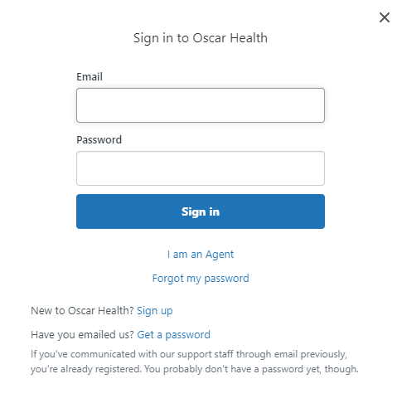
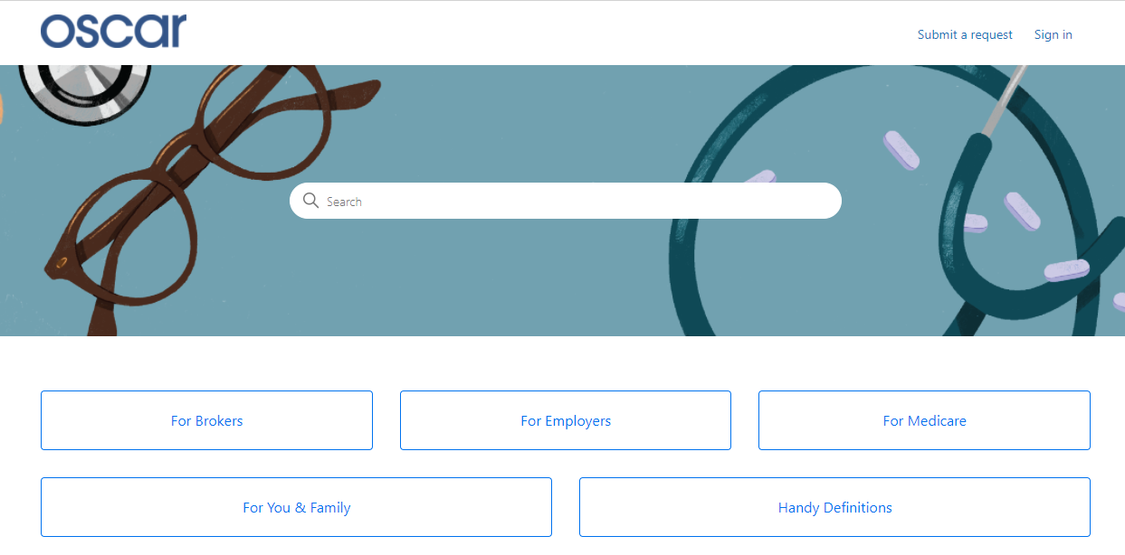
Creating Your Zendesk Account
In order for brokers to communicate with Oscar through the designated emails provided, you will need to create an account through Zendesk. Follow the below steps.
Start at Oscar’s Zendesk Help Center
Click "Sign in" from the top right
A pop-up window will prompt you to sign in. If you don’t have an account, select "Sign up" next to "New to Oscar Health?"
Submit your full name and email address
Click the blue "Sign up" button. Look for an email to complete account set-up.
From your inbox, look for "Welcome to Oscar Health." Click the link to complete creating your password.
You can now successfully communicate to/from, via email, with Oscar.

Slide 46
Health First Health Plans Broker Services is available: Monday through Friday 8:00 a.m. to 5:00 p.m.
For questions contact us at: 321.434.5265 or HFBroker@HF.org

